Slide 1

Hands on with Hadoop
Naren Thilla
Feb 26th 2014
Apache Hive

Slide 2
Introduction
Top level Apache Project – built on top of Hadoop
Originally conceptualized @ Facebook
Leverages MR (default) as the compute engine and HDFS as the storage engine.
Additional compute engines, namely Spark and Tez are available
Motivation:
The Large SQL community
Existing work (HDFS, MR) on Hadoop

Slide 3
What Hive is not?
Hadoop is a batch processing system and Hadoop jobs tend to have high latency and incur substantial overheads in job submission and scheduling. As a result - latency for Hive queries is generally very high (minutes) even when data sets involved are very small (say a few hundred megabytes). As a result it cannot be compared with systems such as Oracle where analyses are conducted on a significantly smaller amount of data but the analyses proceed much more iteratively with the response times between iterations being less than a few minutes. Hive aims to provide acceptable (but not optimal) latency for interactive data browsing, queries over small data sets or test queries. Hive is not designed for online transaction processing and does not offer real-time queries and row level updates. It is best used for batch jobs over large sets of immutable data (like web logs).
Source: The official Hive documentation: https://cwiki.apache.org/confluence/display/Hive/Tutorial

Slide 4
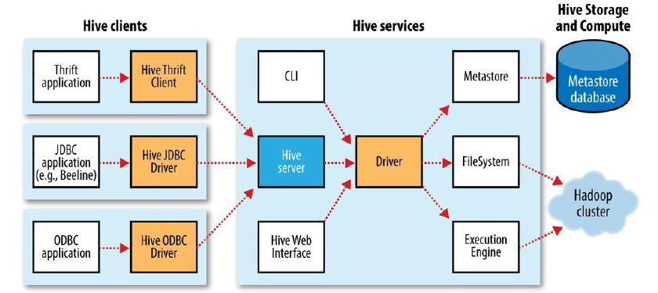
Hive C/S
Ref: Hadoop – The Definitive Guide – 4th Edition

Slide 5
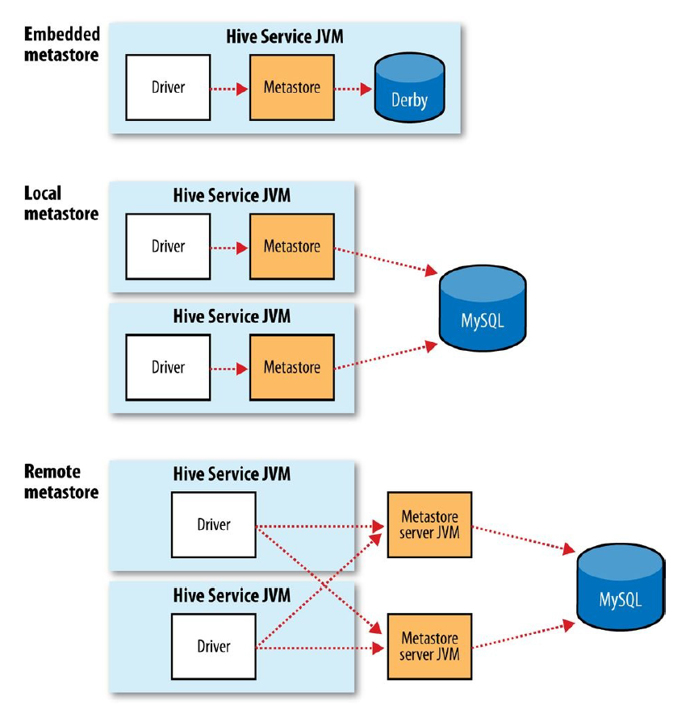
Hive Deployments
Ref: Hadoop – The Definitive Guide – 4th Edition

Slide 6
A Word on Data sets and Code
Several large public datasets available:
http://grouplens.org/datasets/movielens/
http://www.quora.com/Where-can-I-find-large-datasets-open-to-the-public
Alternatively, you can simulate one by using Data Generators such as:
https://www.mockaroo.com/
http://sourceforge.net/projects/spawner/
Code: Z:\DATAMANAGEMENT-DEV\HDP Sessions2\code
Data: Z:\DATAMANAGEMENT-DEV\HDP Sessions\data\hive_spark_core

Slide 7

Examples
Example 1: Loading Data into Hive (NYSE Example)
Example 2: Basic Operations in Hive
Example 3: Managed vs. External Tables
Example 4: Partition & Buckets (Refer Partition Example)
Example 5: Schema on Read Example
Example 6: Functions and UDF in Hive
Example 7: Complex Data Type and Table Generating Function
Example 8: Streaming – An example of Transform function
Example 9: MR Functions – Mapper, Reducer and Transform
Example 10: Data Pipelining
Example 11: SerDe
Example 12: Joins in Hive
Example 13: Indexes on Hive
Example 14: Explain
Example 15: Materialized view in Hive
Example 16: Transaction (ACIDity) in Hive 0.13 and beyond
Example 17: Hive on Spark
Example 18: XML Processing in Hive

Slide 8
Exercise 1: Loading Data and Querying
Goals:
Load Data into HDFS
Create Base and Aggregate tables
Query the table
Code: NYSE.txt
Data: NYSE

Slide 9
Ex 2: Basic Operations in Hive
Refer to cheat sheet at: http://hortonworks.com/blog/hive-cheat-sheet-for-sql-users/
Also at : code/hive/Hortonworks.CheatSheet.SQLtoHive.pdf

Slide 10
Exercise 3: External vs. Managed Table
Managed Tables are internally managed by Hive
By default the corresponding data is stored under /user/hive/warehouse)
When a managed table is deleted, the corresponding data is also deleted.
The external tables are loosely coupled with the schema.
Users need to point the schema to the folder location
When the table is deleted, the data is not deleted.
Code: Hive-Managed vs. External.txt
Data: TwitterData

Slide 11
Ex 4: Partitions and Buckets
Problems with Partitioning:
Partitions may not be of equal size
Dynamic partitions can grow to be very large
Set hive.enforce.bucketing = true; //Helps in defining the number of reducers
Follow instructions at Z:\Datamanagement Dev\...\code\hive\hive-bucket.txt
Code: hive-partitions.txt
hive-partitions vs. bucket.txt
Data: employees.dat

Slide 12
Ex 5: Schema on Read
Schema on Read provides enormous flexibility whereby when the data is ingested, no type checking is done on the data.
This allows for faster data storage
Flexible definition of the schema (changing the schema is easier)
Multiple schema definitions for the underlying data source etc.
Code: hive-SOR.txt
Data: Person

Slide 13
Ex 6: Functions and UDFs in Hive
Standard Functions - abs(), reverse() etc.
User Defined Function (UDF)
Generic UDF vs. UDF (How to handle Nulls and Exception)
Temporary vs. Permanent UDF
User Defined Generic Function (UDGF) vs. User Defined Aggregate Function (UDAF)
Code: hive-udf.txt
JAR: HiveUDFTest.jar, HivePipelineUDFTest.jar
Data: Person
2. https://github.com/edwardcapriolo/hive-geoip/
code: geoip.txt
data: GeoIP.dat
Jar: geo-ip.jar, hive-udf-geo-ip-jtg.jar;
3. hive-wc.txt

Slide 14
7a ) Loading Binary Data
employees.dat is a binary file and you need to edit it in Binary Editor.
Use the Binary editor HxD from z:\Data management Dev\...\software\HxD.exe to edit the same.

Slide 15
Ex 7b: Complex Data Type, Table Generating Functions and Lateral Projections
Code: hive-complex datatype.txt
Data: Employees.dat

Slide 16
Ex 7c: Table Generating Function
Code: hive-table-gen-func.txt

Slide 17
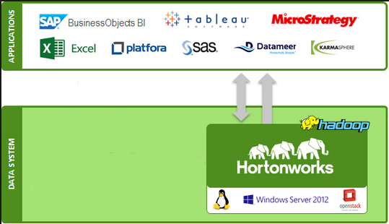
BI on Hive
Install MapR ODBC Driver
Use XL or Qlikview to connect through ODBC
Code: hive-omniture
ominture.pbix
Dataset: ominture

Slide 18
Hive - Wc
How do you write a word count example in Hive?
Data set: Charles Dickens – A Tale of Two cities

Slide 19
Ex 8: Streaming, Transform & Distributed Cache
Streaming allows users to leverage programs written in languages other than Java such as python, c, unix shell script etc
Uses the Unix Stream concept
Example of a stream in unix:
$ ls-l | grep rwx
Distributed Cache
An example celcius to Farenheit conversion;
Code: hive-transform.txt
Data: Charles Dickens/A Tale of Two Cities
Dependency : Table “wc” from previous example.
hive-distributed-cache.txt
Shell script: ctof.sh
Dataset: Zip

Slide 20
Ex 12: SerDe
So what is SerDe?
Stands for Serialize, Deserialize (also marshall and unmarshall)
Simply put, it is a mechanism to flatten data structure.
The flattened data is then used for persisting or for transporting on the wire.
Helps in platform neutrality
Run the Java Custom SerDe
Custom SerDe: http://blog.cloudera.com/blog/2012/12/how-to-use-a-serde-in-apache-hive/
Code: Hive-XML-SerDe
Hive-RegEx SerDe
Jar File: hivexmlserde-1.0.5.1.jar (from IBM)
Data: Activations

Slide 21
Ex 14:Transactions in Hive
Starting from Hive 0.13, Transactions are supported partially
Update and Delete semantics supported
ACIDity supported (but no commit, rollback yet. All transactions are auto-commit)
Tables must be marked transactional (v 0.14 onwards)
https://cwiki.apache.org/confluence/display/Hive/Hive+Transactions
http://en.wikipedia.org/wiki/CAP_theorem
https://cwiki.apache.org/confluence/display/Hive/LanguageManual+ORC (Hive v0.11)
Note: Run Instructions at : Hive-Txn.txt

Slide 22
Ex 15: Hive on Spark
http://www.cloudera.com/content/cloudera/en/documentation/hive-spark/latest/PDF/hive-spark-get-started.pdf
Copy z:\Data Management Dev\...\code\hive\ hive-onspark.conf to /etc/hive/conf folder
Take a backup of hive-site.xml (mv to hive-site.xml.bk)
Mv hive-onspark.conf to hive-site.xml
Start Hive.
Hive> .3
Hive> Select * from price_data where symbol=‘IBM’;
Hive> set hive.execution.engine=mr;
Hive> Select * from price_data where symbol=‘IBM’;
Compare time taken – 0.26 to 0.5 vs. 0.1 seconds
Note: Do not run Aggregate functions yet;
Also, HoS is available only from Hive 0.14 or later versions
Also, read a sample of the tech wars on Hive’s future:
http://hortonworks.com/blog/cloudera-just-shoot-impala/

Slide 23
Ex 17: XML Processing in Hive
2 ways of processing XML data:
Pure Text Processing using Xpath (Without SerDe)
Loading XML data into Hive Table (using XML SerDe)
Code/hive/hive-xml-test.txt (without SerDe)
Code/hive/hive-xml-serde.txt (with SerDe)

Slide 24
Wikipedia Text Analytics – Case Study
Wikipedia makes the entire text available for public consumption
The latest English dumps are here:
http://dumps.wikimedia.org/enwiki/latest/
Extract the ones enwiki-latest-pages*.bz2 http://dumps.wikimedia.org/enwiki/latest/enwiki-latest-pages-articles.xml.bz2
This is 12 GB compressed and 42 GB uncompressed
36,423,851 pages under 4,884,940 articles
-http://en.wikipedia.org/wiki/Wikipedia:Size_of_Wikipedia
Step 1: Extract the above dataset and filter for enwiki-latest-pages*.bz2
Run the spark Program spark-wiki-toc.txt isolates 3 files and you can find out the size of each extractions.
The 3 dumps below total – 47GB
http://dumps.wikimedia.org/enwiki/latest/enwiki-latest-pages-articles-multistream.xml.bz2
http://dumps.wikimedia.org/enwiki/latest/enwiki-latest-pages-articles.xml.bz2
http://dumps.wikimedia.org/enwiki/latest/enwiki-latest-pages-meta-current.xml.bz2

Slide 25
Wikipedia Case Study (Contd)
Step 2: Load the data into HDFS (preferably in Google Cloud)
Step 3: Use XML SerDe to create a Hive Table
Code available in z:\datamanagement-dev\...\code\hive\hive-wiki.txt
Step 4: Run the queries to your heart’s content
Note: Running a query against a 3 node cluster ran out of resources. One option is to run WikiExtracctor.py (py program under Z:\DATAMANAGEMENT-DEV\HDP Sessions\software binaries\WikiExtractor\WikiExtracctor.py)
Extract a subset of pages and load into Google Cloud:
WikiExtractor –cb 1G -o extracted itwiki-latest-pages-articles.xml.bz2
Refer : http://medialab.di.unipi.it/wiki/Wikipedia_Extractor

Slide 26
Assignment
Yelp Databases
Movie Database

Slide 27
Appendix

Slide 28
Ex 5: Joins in Hive
Inner Join
Only Equijoins supported. The following non-equi join is NOT supported
SELECT a.ymd, a.price_close, b.price_close
FROM stocks a JOIN stocks b
ON a.ymd <= b.ymd
WHERE a.symbol = 'AAPL' AND b.symbol = 'IBM';
Left Outer, Right Outer, Inner, Full-outer, Left – Semi Joins supported.
No Intersect, Minus supported
Note: Hints and map-side joins available for optimization.
Intersect:
SELECT DISTINCT a.* FROM a INNER JOIN b on a.PK = b.PK
Minus:
SELECT DISTINCT a.* FROM a LEFT JOIN b on a.PK = b.PK WHERE b.PK IS NULL

Slide 29
Advantages of Hive over SQL
Complex Data types (collections etc) supported
Flexible record format and support for binary data
SerDes and InputFormatters
UDFs – UDGF and UDAF
Plugggable Execution Engine
Support for JDBC/ODBC
Native support for Partitioning and Bucketing
Support for leveraging “other” libraries using Streams

Slide 30
Disadvantages
Does not support ANSI fully (work in progress)
Secondary index support missing
Not suitable for OLTP type queries (no commit, rollback etc)

Slide 31
Query processing in Hadoop
HiveQL
SQL
SQL support
Hive Engine
Spark-SQL
Engine
SQL Engine
SQL Engine
MapReduce
Tez
Spark
Distrided
Execution
Linux Cache
Cache
Block Cache
ORC File
Parquet File
Storage
Columnar Storage
Columnar Storage

Slide 32
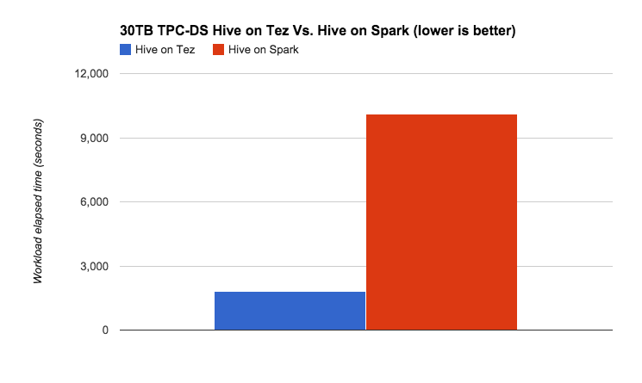
Hive on Spark vs. Hive on Tez – Which one to use?
10,098
1,828
Source: Hortonworks
https://gigaom.com/2014/07/20/spark-and-tez-out-of-phase/

Slide 33
Additional Concepts
Hive Indexes (Bitmap and Regular Index)
Explain Plan
Compression
Columnar Storage
Map side Joins

